Slide 1
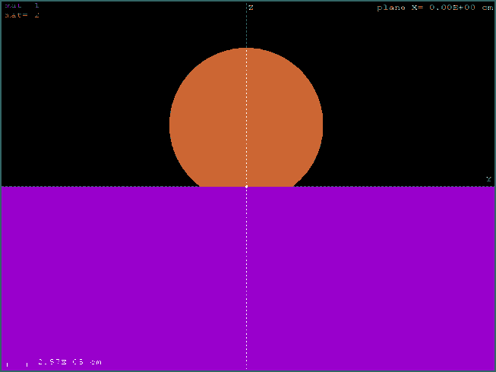
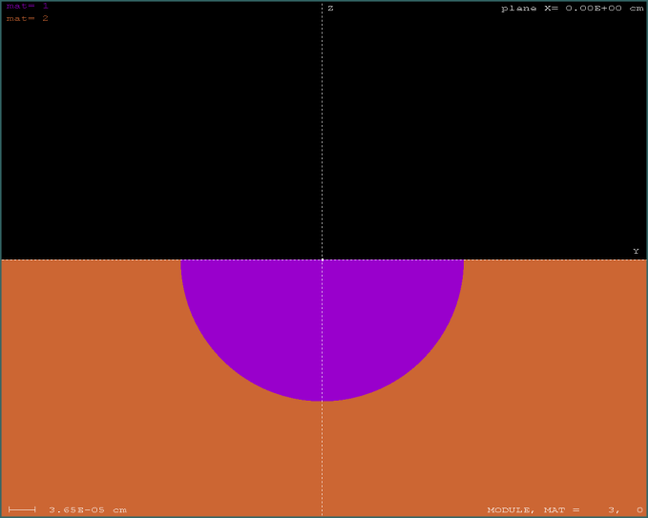
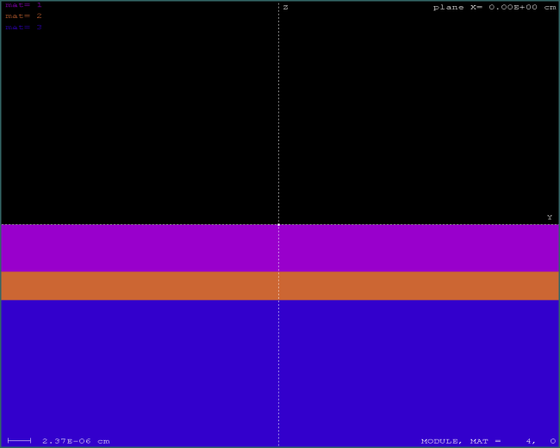
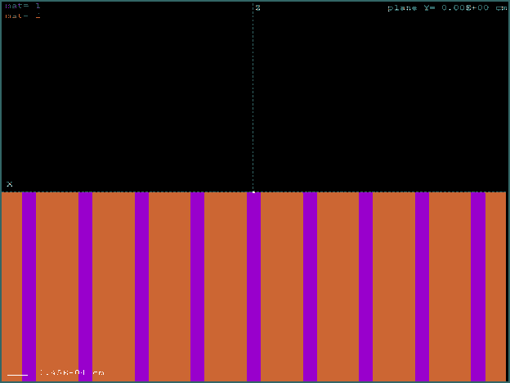
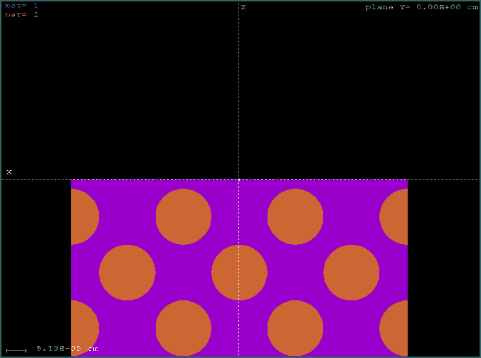
Analysing samples with complex geometries
Particles
Inclusions
Multilayers
etc…
Lamellae & phase boundaries
Bubbles

Slide 2
The simulation code PENELOPE
Salvat et al. (1996 2014)
PENetration and Energy LOss of Positrons
and Electrons (... and photons)
General-purpose Monte Carlo subroutine package for the simulation of coupled electron-photon transport in arbitrary geometries (75 eV – 1 GeV)
Developed and maintained at the UB. Distributed by the OECD-NEA Data Bank (Paris)
http://www.nea.fr/lists/penelope.html
PENEPMA: EPMA simulations made easy
Based on PENELOPE. Latest version v. 2014
You can define the energy, direction and position of the electron beam
The geometry of the sample (and its environment) is defined by using
PENGEOM
Provides the x-ray spectrum at different photon detectors

Slide 3
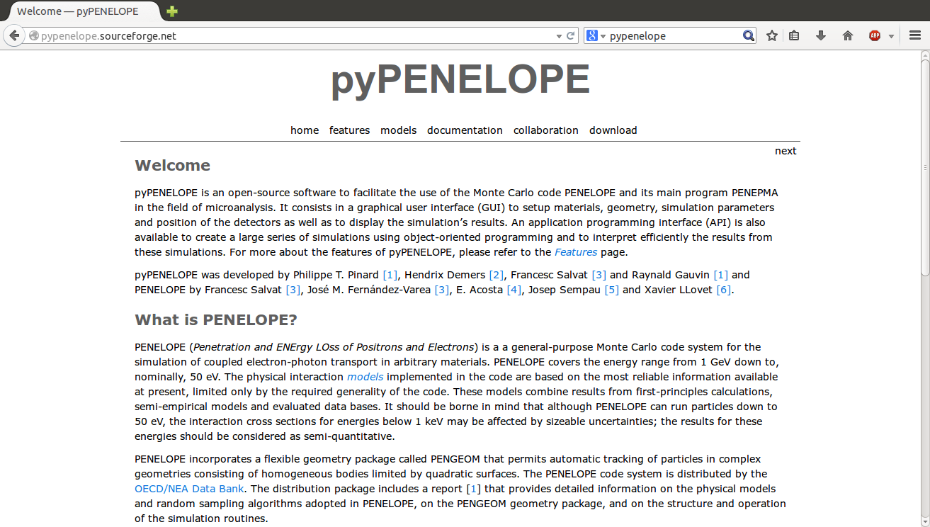
Running PENEPMA with PYPENELOPE (v. 2011)
Interface created by Philippe Pinard
http://pypenelope.sourceforge.net

Slide 4
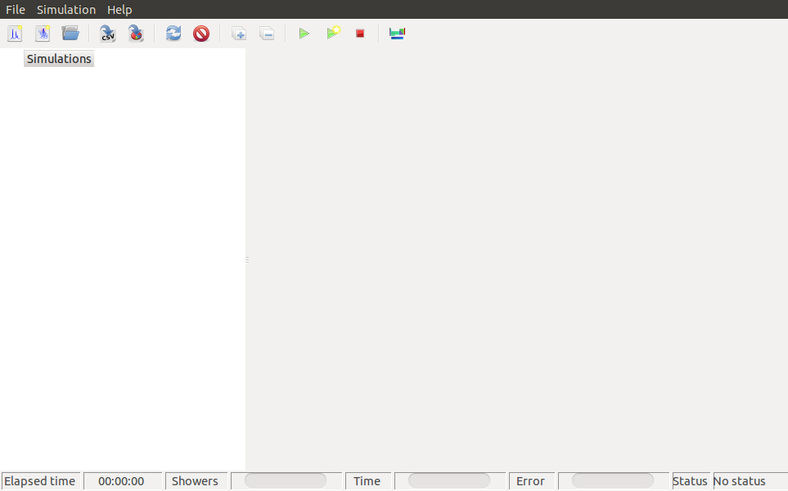
Running PENEPMA with PYPENELOPE
Defining a new simulation
Starting a new simulation

Slide 5
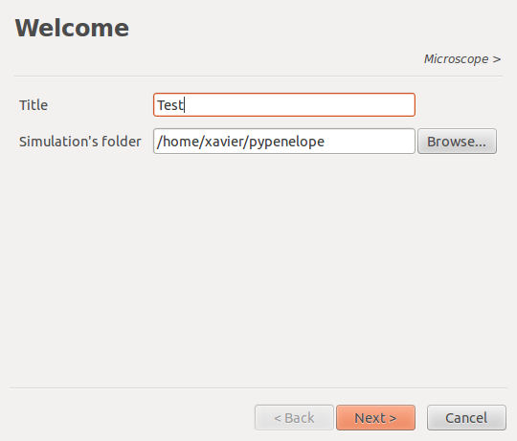
Running PENEPMA with PYPENELOPE
Simulation’s folder & title

Slide 6
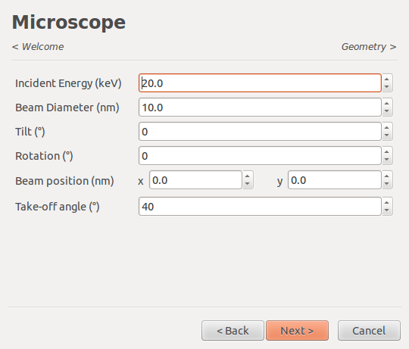
Running PENEPMA with PYPENELOPE
Incident electron beam characteristics

Slide 7
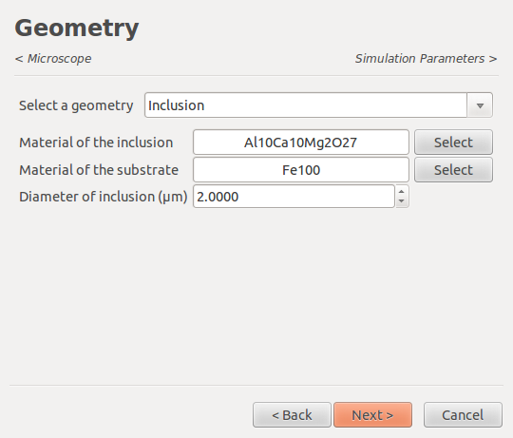
Running PENEPMA with PYPENELOPE
Sample geometry: bulk, multilayer, inclusion, grain boundaries

Slide 8
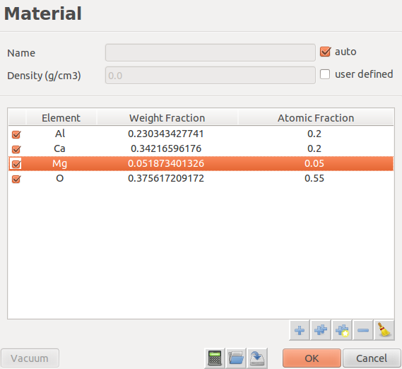
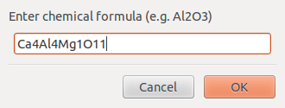
Running PENEPMA with PYPENELOPE
Material compounds can be defined by means of their chemical formula

Slide 9
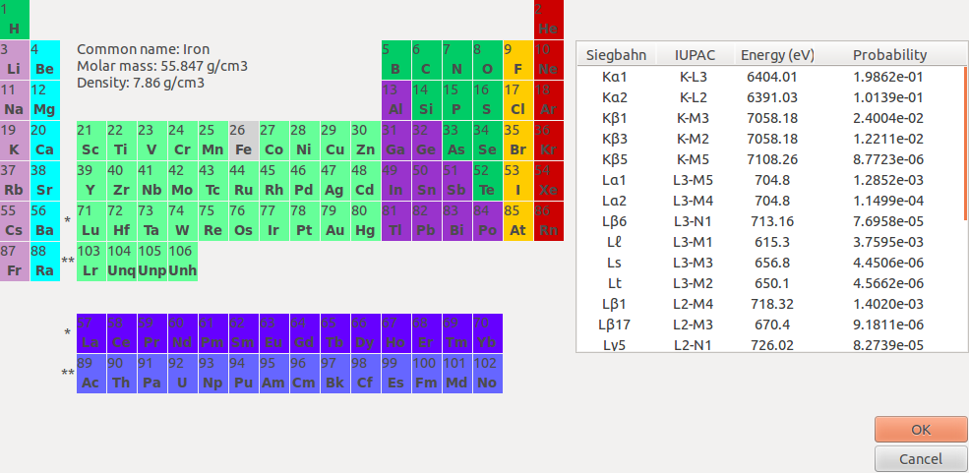
Running PENEPMA with PYPENELOPE
… or by clicking each element in the periodic table

Slide 10
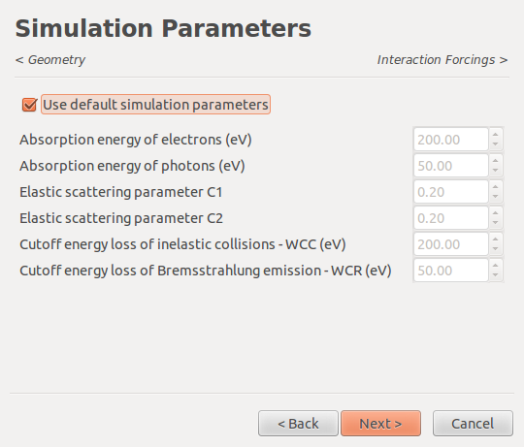
Running PENEPMA with PYPENELOPE
Simulation parameters related to the mixed simulation algorithm of PENELOPE: Eabs (electrons & photons), C1, C2, WCC, WCR

Slide 11
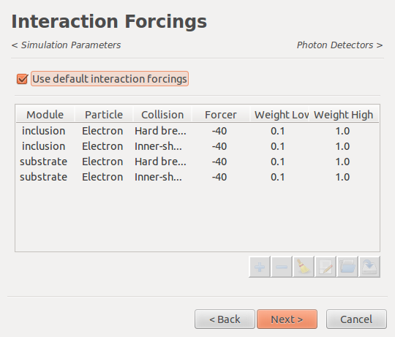
Running PENEPMA with PYPENELOPE
Interaction forcing values for each interaction mechanism e.g. ionization & bremsstrahlung emission

Slide 12
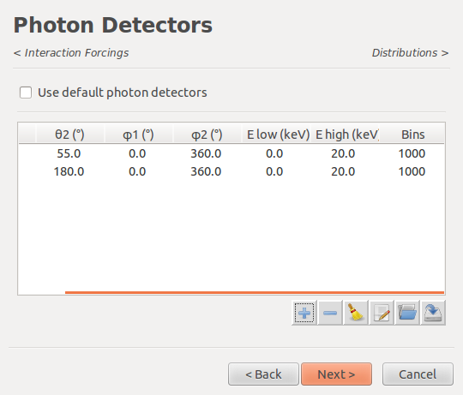
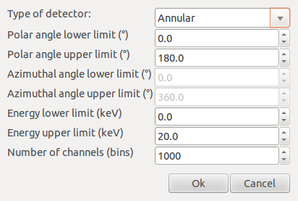
Running PENEPMA with PYPENELOPE
Different kind of photon detectors can be defined

Slide 13
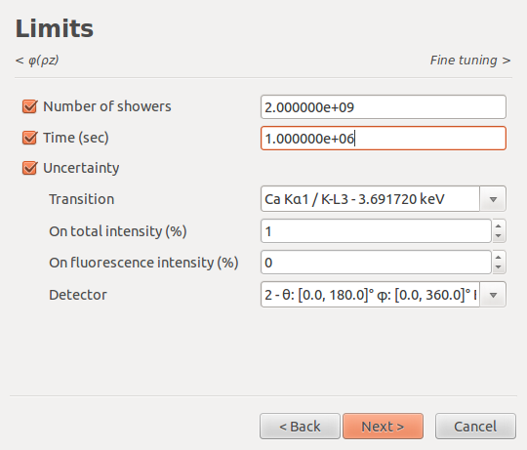
Running PENEPMA with PYPENELOPE
A simulation will stop if the number of showers, simulation time or uncertainty on a specific X-ray line is reached

Slide 14
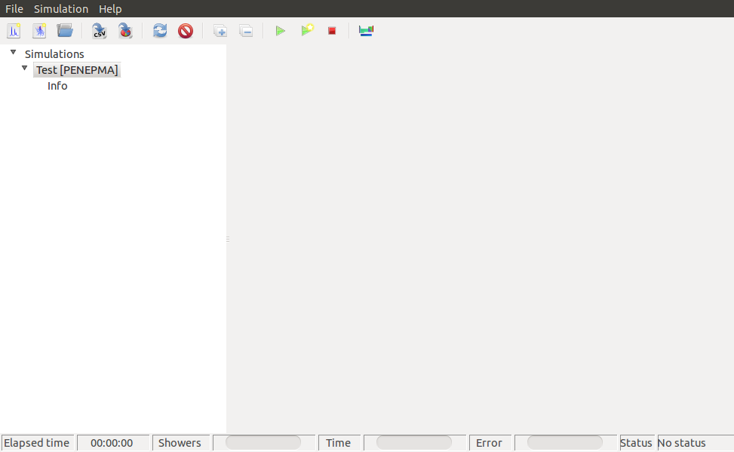
Running PENEPMA with PYPENELOPE
Running the defined simulation

Slide 15
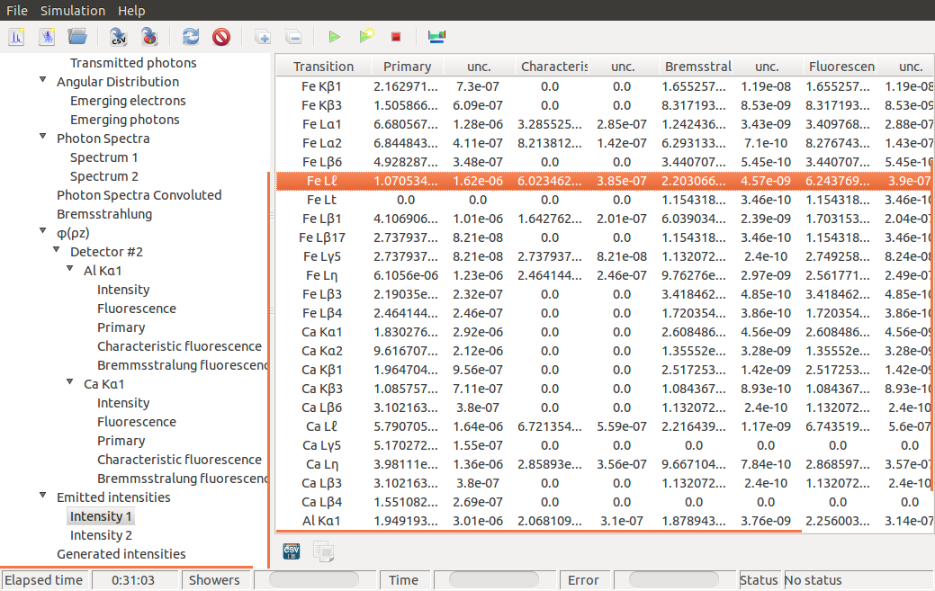
Running PENEPMA with PYPENELOPE
Characteristic X-ray intensities (primary, fluorescence characteristic, fluorescence bremss, total) and statistical uncertainties

Slide 16
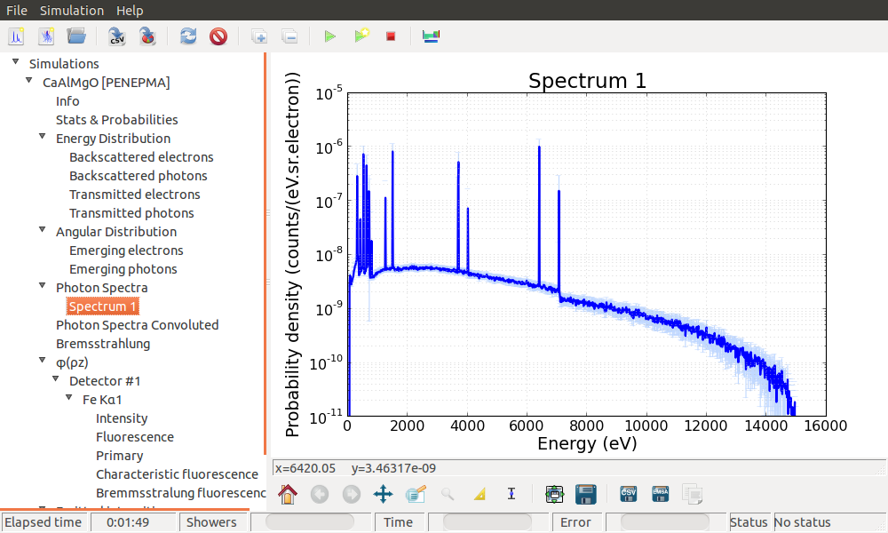
Running PENEPMA with PYPENELOPE
Results can be visualized on-line or exported to data files

Slide 17
Running PENEPMA manually
To run PENEPMA manually we usually must prepare:
Geometry definition file (PENGEOM)
The corresponding material-data files (by running the program material)
The input file containing details on the electron beam, simulation parameters, detectors, variance reduction, methods and spatial distribution of x-ray events, simulation time or number of trajectories, etc
Advantages of running PENEPMA manually:
Parallel processing possible (v. 2014)
Any geometry can be defined (sample, microscope, etc..)
2D distributions of X-ray emission can be obtained
Scripts prepared to visualize output results using gnuplot

Slide 18
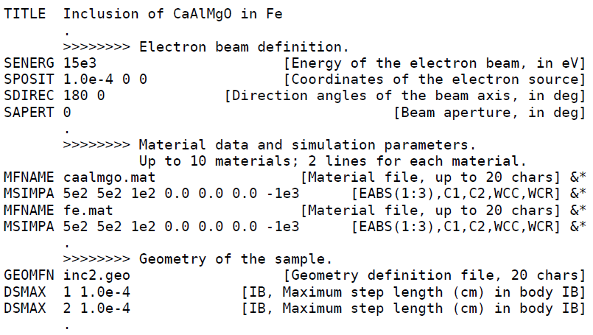
Preparing the input file

Slide 19
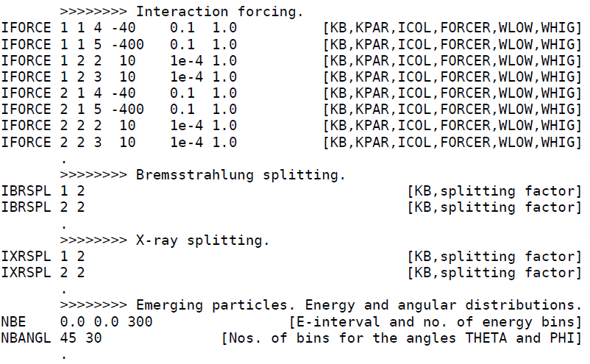
Preparing the input file

Slide 20
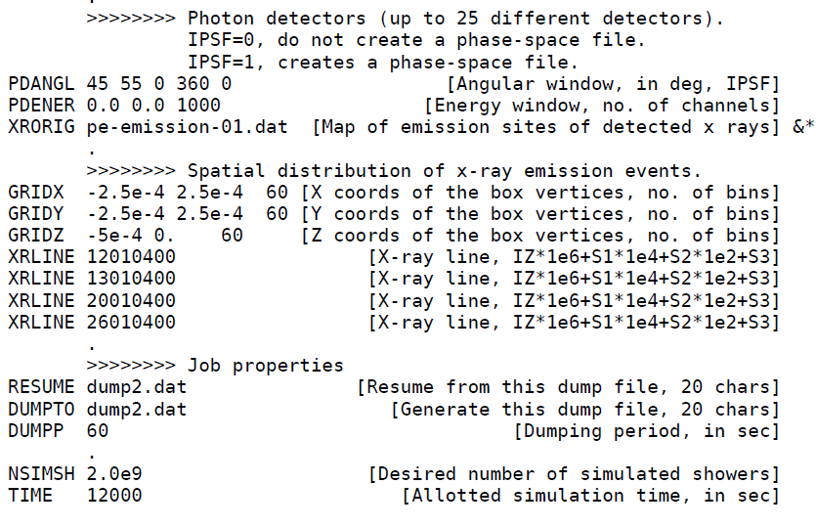
Preparing the input file

Slide 21

Example: Ca₄Al₄MgO₁₁ inclusion on Fe
z
E = 15 keV
electron beam
(y = 1μm, x = 0μm)
y
Ca₄Al₄MgO₁₁
r = 2 μm
Fe

Slide 22
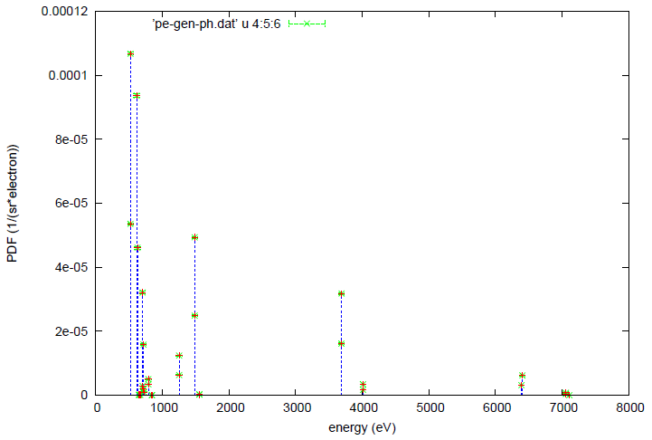
Results: characteristic x-ray spectrum
O
Si
Mg
Ca
Fe

Slide 23
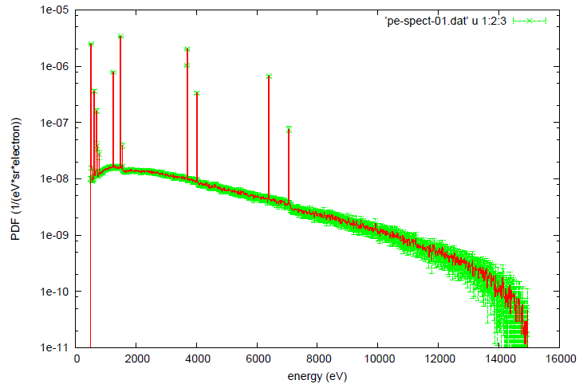
Results: EPMA spectrum
O
Si
Mg
Ca
Fe

Slide 24
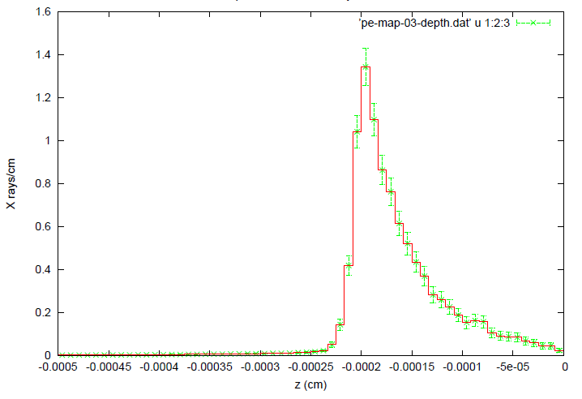
Results: depth distribution of X-ray emission (Fe Kα)

Slide 25
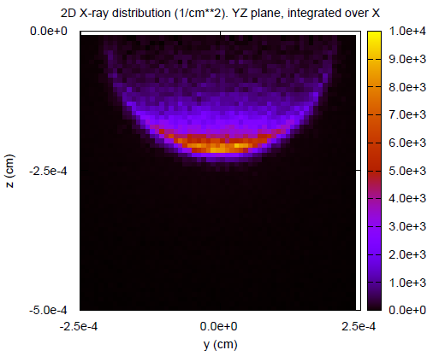
Fe Kα

Slide 26
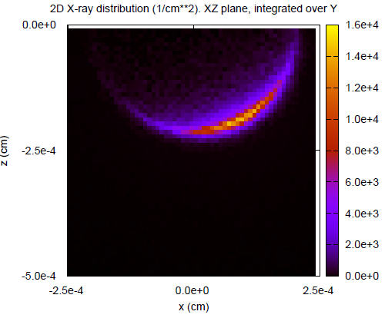
Fe Kα

Slide 27
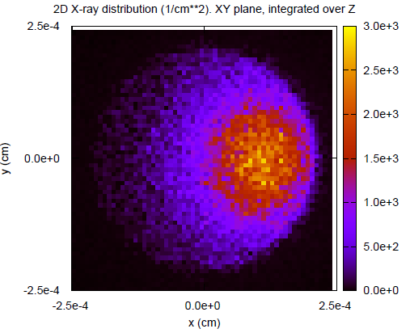
Fe Kα

Slide 28
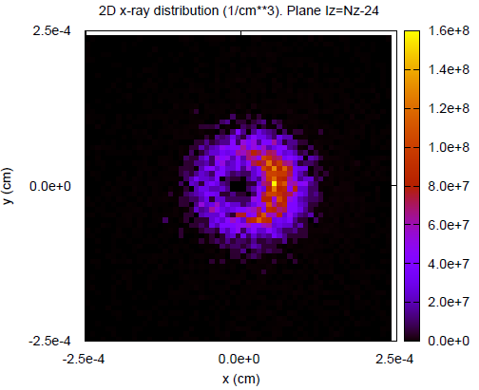
Fe Kα

